Slide 1
2023 Fauquier County Election Results and Analysis

Slide 2
Strategy – Ends
Convince as many low- to moderate-propensity Republican voters as possible to vote for Republican candidates in the 2023 election
Convince an increased number of Republicans to vote early or by absentee ballot
Ensure Fauquier County runs a “clean,” and fair election

Slide 3
Strategy – Ways
Target voters in rural areas via four directed mailings that supported local and state Republican Candidates
Target voters in more densely populated areas via a concentrated door-knocking effort and a series of local events designed to support Republican candidates
Target potential Republican voters at precinct polling stations on election day and provide them with sample ballots that identified the candidates that the FCRC endorsed
Thoroughly train as many poll watchers as possible and position them at the most critical polling stations (as identified by the RPV and candidates)

Slide 4
Strategy – Means
Budget of ~$10K
Voter data bases provided by the Candidates and the RPV
Two door-knocking apps: i360walk and Campaign Sidekick
FCRC-designed postcards/letter that supported our local/state candidates and promoted early/mail-in voting
Campaign handouts and signs provided by the candidates
Sample ballots that identified FCRC-endorsed candidates

Slide 5
Overview of FCRC’s GOTV Effort
Door-Knocking
Over 2,000 doors knocked in Warrenton, Vint Hill, Bealeton, and Marshall
Door-knocking conducted by a cadre of 10-15 volunteers
Directed Mailing
Over 19,000 letters and postcards mailed out in support of Republican candidates
Directed mailings completed by a cadre of ~45 volunteers
Poll Working
Over 15,000 thousand sample ballots provided to prospective voters
All 24 polling stations manned for the entire day
Poll Watching
70% of polling stations (17) covered; all “critical” polling stations covered

Slide 6
Highlights of 2023 Election Results
Total Number of Voters: 26,774 (EV - 7,824 / ED - 16,691 / MA - 2,259)
More than one third of voters (37.7%) voted early or by mail-in ballot
BUT – Total represents less than half (48.4%) of county’s voters
2023 Republican voter turnout increased ~17% over 2019 election (the last election for local and state positions)
17 of 19 Republican state and local candidates won their races
16,537 (62%) voted for Republican Senate candidates (Reeves & Segura)
17,034 (64%) voted for Republican Delegate candidates (Webert & Higgins)
Precincts with the largest Republican voter turnout: (1) Waterloo, (2) New Baltimore, (3) Catlett, and (4) Vint Hill
Precincts with the largest percentage Republican votes: (1) Catlett (76%), (2) Opal (74%), (3) Lois (74%), (4) Kettle Run (72%), (5) Morrisville (72%)

Slide 7
Preliminary Insights
The increase in directed mailings appeared to have a positive impact on Republican voter turnout – particularly in the rural areas of the county
Sample ballots continue to be very important on election day
Proximity to early polling stations makes a difference (i.e., Warrenton, Bealeton, and Vint Hill) – need sample ballots at these sites
County Republicans still don’t want to take advantage of mail-in voting
Need to hone our door-knocking efforts; 1 day per week during campaign season doesn’t appear to be enough
Bottom Line: We’re moving in the right direction but still have lots of room for improvement

Slide 8
Back-Up Slides

Slide 9
Fauquier County Voter Turnout

Slide 10
Senate Election Results Fauquier County

Slide 11
Delegate Election Results Fauquier County

Slide 12
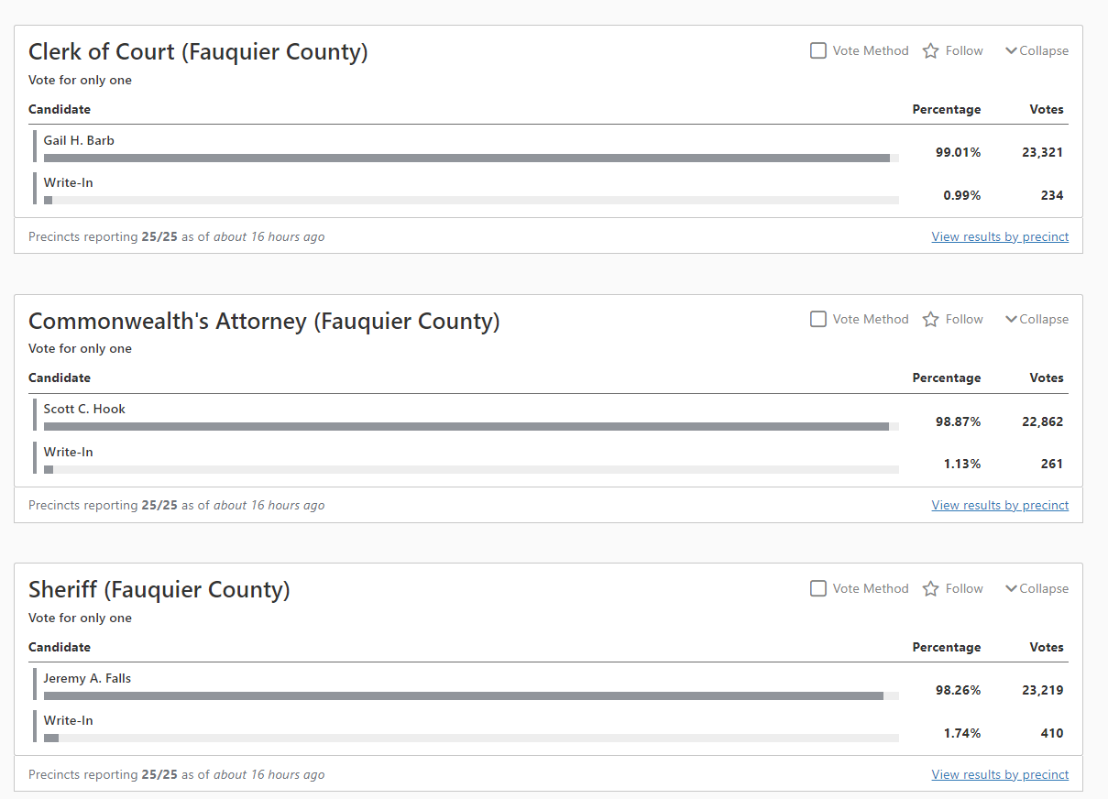
Local Election Results Fauquier County

Slide 13
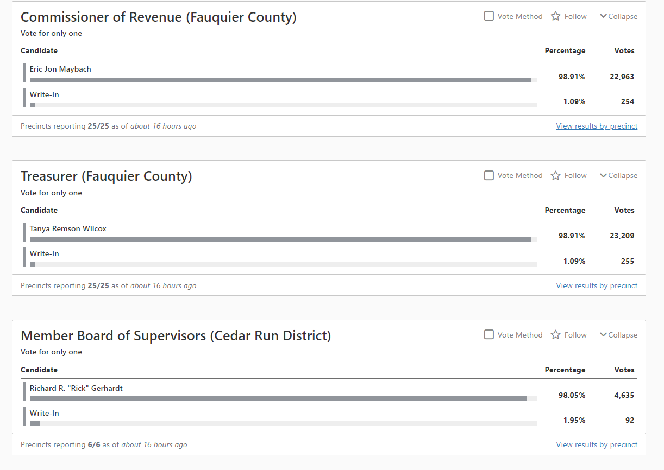
Local Election Results Fauquier County

Slide 14
Local Election Results Fauquier County

Slide 15
Local Election Results Fauquier County

Slide 16
Local Election Results Fauquier County

Slide 17
Local Election Results Fauquier County

